Slide 1

By: Team-2

Slide 2
Content
Overview
Team Introduction
Scope / Features
Technology Architecture
Tools & Technologies
Demo
Future Roadmap
Appendix
Use-Cases
Flow Diagram
Class Diagram
Sequence Diagram

Slide 3
Overview
QURE is a doctor consultation website where patients can book appointments with the doctors registered in qure network online and get notified about that. It also helps the doctors to manage their appointments.
Patients can even consult the doctors through chat. It also provides a feature of booking medicines from the qure pharmacy.

Slide 4
TEAM
Athul KS
Arjun M
Amulya Meka
Aaruni Aggarwal
Alok Kumar
Gayatri Sama
Ragini Garg

Slide 5
Scope / Features
Patient/doctor registration
Patient/doctor/admin login and profile management
Appointment management for doctor/patient
Admin can manage the doctor and the pharmacy
Internationalization: support multiple languages
User friendly UI
SMS/E-mail notification on booking
Chat with the doctor
Order Medicine
Rating the doctor
Forgot password

Slide 6
Tools & Technologies
BACKEND:
SPRING BOOT
JAVA
FRONTEND:
ANGULAR
BOOTSTRAP
HTML & CSS
DATABASE
MONGODB
Git / GitHub
STS
Websocket
StompJs

Slide 7
Technology Architecture
RE
ANGULAR
SPRING BOOT
MONGODB
BROWSER
CONTROLLER
SERVICE
REPOSITORY
BOOTSTRAP
RESTAPI
SPRING DATA
HTML CSS
QURE DATABASE
QURE UI
(FRONT END)
QURE SERVICE
(BACK END)

Slide 8
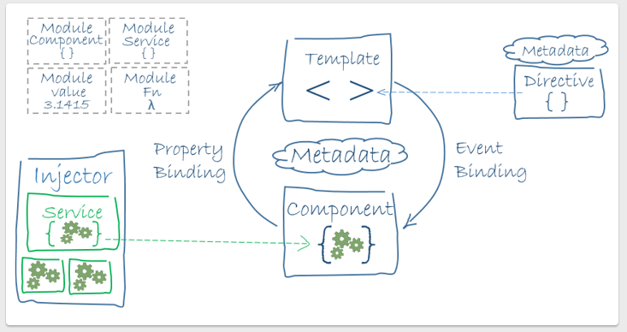
Front End Architecture

Slide 9
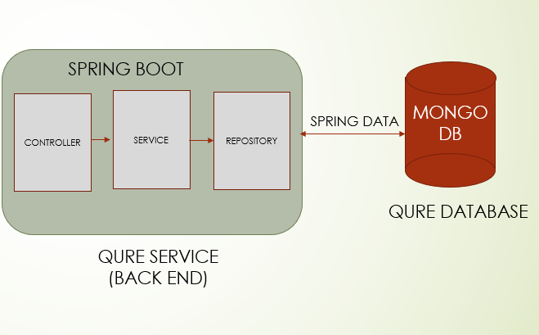
Back End Architecture
HTTP Request
HTTP Response

Slide 10
FrontEnd Components
About
Admin
AdminLogin
AdminDoctor
AdminPharmacy
Appointments
Authentication
Blogs
Chat
Contact
Devteam

Slide 11
Doctor
DoctoLogin
DoctorRegister
Faq
Home
OrderMedicine
BookMedicine
Patient
PatientLogin
PatientRegister
Shared
Header
Footer
Specialisation

Slide 12
Controllers, Services And Models
AdminController
AdminService
Address
AppointmentService
Admin
AppointmentController
BookMedicineService
Appointment
BookMedicineController
BookMedicine
DoctorService
DoctorController
Doctor
MedicineService
MedicineController
Medicine
MessageService
Patient
PatientController
PatientService
Person
PharmacistController
PharmacistService
ResponseMessage

Slide 13
Dependencies
spring-boot-starter-web
persistence-api
spring-boot-starter-data-mongodb
commons-lang
spring-boot-starter-test
spring-boot-devtools
spring-boot-starter-actuator
spring-boot-starter-security
spring-boot-starter-mail
twilio-java-sdk

Slide 14
DEMO

Slide 15
Future RoadMap
Payment function for the patients
Tracking of the medicine orders
FollowUp records of patients
Uploading the Prescription

Slide 16
Appendix

Slide 17
Use-Cases
Patient
‣ Registration online
‣ Book / Cancel an appointment
‣ Order medicine
‣ Chat with doctor
Doctor
‣ Doctor can cancel appointment
‣ Chat with patient
Admin
‣ Delete doctor’s record
‣ Manage the pharmacy with medicines and orders

Slide 18
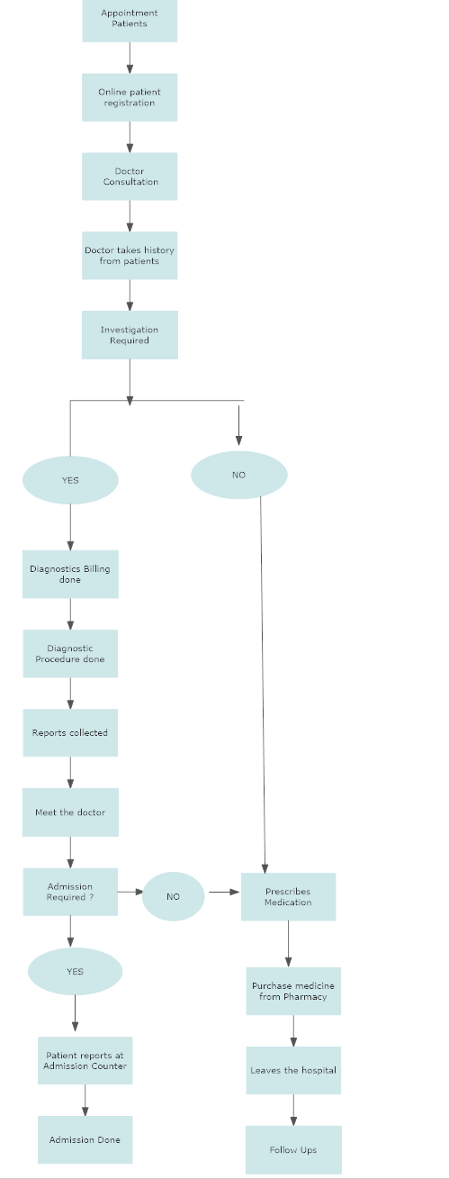

Slide 19
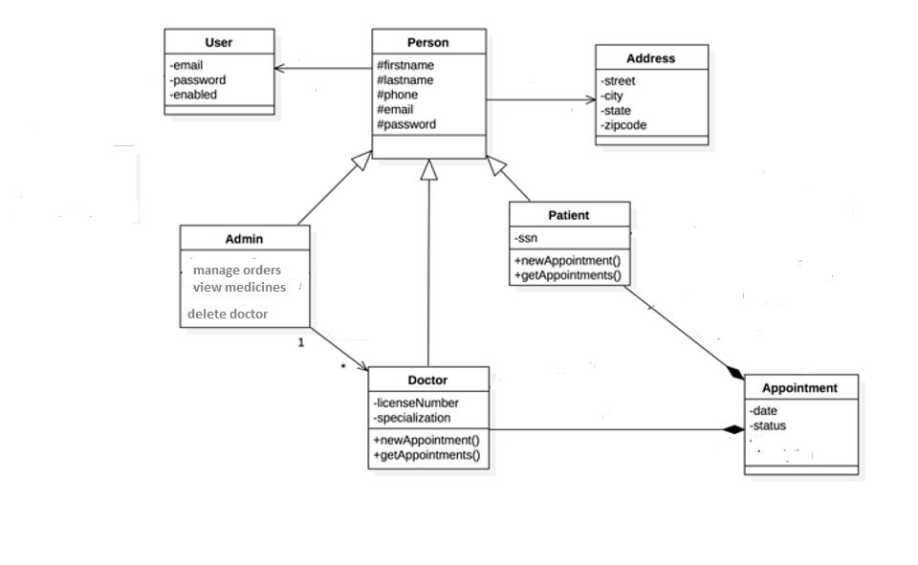
Class Diagram

Slide 20
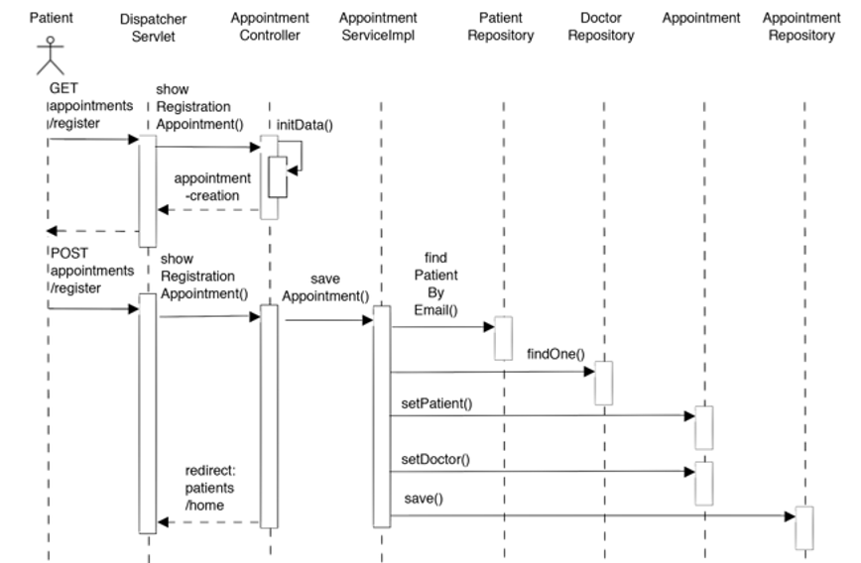
Appointment Sequence Diagram

Slide 21
THANK YOU

